Slide 1
WALES’ FIRST RESPONDER MODERN SLAVERY COURSE
Notes:
Ensure you have already mixed up your delegates into groups from different agencies on each table – this will save messing around later.
MAXIMUM NUMBER OF DELEGATES 25 PER COURSE (5 tables of 5)

Slide 2
HOUSEKEEPING
Fire Safety
Toilets
Mobile Phones
Timings and breaks
Smoking
Notes:
TRAINER TO:
Check with venue if there are any fire drills planned for that day and where the fire exits and assembly points are. Also the toilets.
Ask delegates to switch off mobile phones or put on silent. If calls need to be taken then they should leave the room.
Give a rough idea of what time breaks will be and how long they will get.
Check with the venue where delegates must go to smoke.

Slide 3
DVD
Notes:
Ask delegates to close their eyes & play Nok’s Journey
Start the track at 1:30

Slide 4
AIM
To develop knowledge and skills so you can understand and respond appropriately in working as a First Responder in modern slavery

Slide 5
OBJECTIVES:
By the end of the course delegates will be able to:
Describe modern slavery
Explain legislation and policies in modern slavery
Identify an exploited person
Explain the role of local and national agencies in modern slavery
Examine how modern slavery affects individuals
Identify responsibilities for responding to modern slavery issues
Complete a National Referral Mechanism form for children and adults.
Understand your responsibilities for referral
CSE/ County lines to human trafficking, non-first responder organisation

Slide 6
WHAT IS MODERN SLAVERY?

Slide 7
WHO ARE FIRST RESPONDERS?
In Wales, the statutory first responders are:
local authorities,
the police force,
UK Visas and Immigration and Border Force
The Gangmasters Labour Abuse Authority.
NGO first responders in Wales:
BAWSO
New Pathways.
Other first responders in the UK include Salvation Army, the NSPCC, and Barnado's.

Slide 8
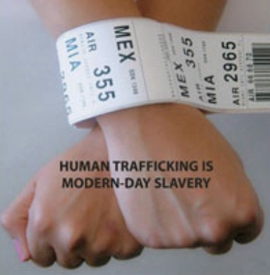
WHAT IS MODERN SLAVERY?
Notes:
The most simple explanation for ‘slavery’. Despite being outlawed on both sides of the Atlantic since 1805, the trade in human slaves has not stopped. It has simply been driven ‘underground’ by being prohibited.
Modern slavery includes: human trafficking, slavery, servitude, forced & compulsory labour
Human trafficking is the fastest growing form of slavery today and is prohibited under international law, as well as under the criminal laws of the United Kingdom and other countries.
The home office estimated in 2013 there were between 10,000 & 13,000 victims of modern slavery in UK
8

Slide 9
DEFINITION
Originates from The Palermo Protocols;
To Prevent, Suppress and Punish Trafficking in Persons, especially Women and Children;
The Protocol against the Smuggling of Migrants by Land, Sea and Air;
The Protocol against the Illicit Manufacturing and Trafficking in Firearms, Their Parts and Components and Ammunition.
Notes:
The Palermo protocols are three protocols that were adopted by the United Nations to supplement the 2000 Convention against Transnational Organized Crime (the Palermo Convention).
Human trafficking is the illegal trade of human beings, mainly for the purposes of sexual exploitation or forced labour. The Palermo Protocol was signed by the UK in 2000 and provides the first internationally recognised definition of human trafficking.
More recently there has been a slight amendment to this in the addition of the term ‘begging’ which has been agreed by many countries.
The UK has decided to opt out of this amendment at this time. This has resulted in significant lobbying by children’s charities to the UK Government.

Slide 10
TRAFFICKING IN PERSONS IS DEFINED AS:
The recruitment, transportation, transfer, harbouring or receipt of persons, by means of the threat or use of force or other forms of coercion, of abduction, of fraud, of deception, of the abuse of power or of a position of vulnerability or of the giving or receiving of payments or benefits to achieve the consent of a person having control over another person, for the purpose of exploitation.
Exploitation shall include, at a minimum, the exploitation of the prostitution of others or other forms of sexual exploitation, forced labour or services, slavery or practices similar to slavery, servitude or the removal of organs.
Notes:
Modern slavery is an umbrella term that covers the offences of human trafficking & slavery, servitude & forced or compulsory labour.
Exploitative behaviours involved in these crimes is often similar.
It would be a good idea to have this to hand every time you complete an NRM form to ensure you have covered all the requirements for a trafficked victim.

Slide 11
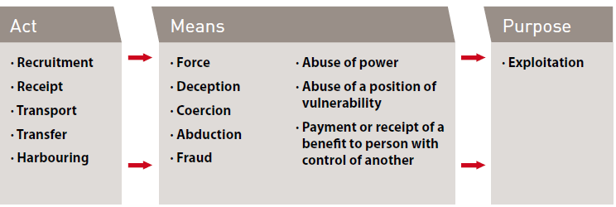
CONSTITUENT ELEMENTS OF TRAFFICKING
Notes:
Child trafficking = Act & purpose only
Forced Labour = Means & Service. Service means as a result of the means an individual provides a service for benefit, e.g. begging, sexual services, manual labour & domestic service
Child forced labour = service only
All three of the following items must be present in order to meet the definition of trafficking, unless the person trafficked is under the age of 18, in which case the ‘means’ is irrelevant. In such cases, only the ‘act’ and ‘purpose’ need be present.
The Act (What is done)
Recruitment, transportation, transfer, harbouring or receipt of persons.
The Means (How it is done)
Threat or use of force, coercion, abduction, fraud, deception, abuse of power or vulnerability, or giving payments or benefits to a person in control of the victim.
The Purpose (Why it is done)
For the purpose of exploitation, which includes exploiting the prostitution of others, sexual exploitation, forced labour, slavery or similar practices and the removal of organs or body tissue.
NB: It is imperative to highlight here the importance of practically ticking off the categories under each heading. Under each heading the First responder will need to evidence how the person is a trafficked victim when completing the NRM form. You only get one chance to claim safety for this person.
We will go into more detail of this later on today.
Trafficking is not an immigration crime. Trafficking is a crime against a person.
Immigration crime is a crime against the State.
The principal difference between people smuggling and human trafficking is the element of exploitation. It is important to examine the end situation when the victim is recovered to determine whether they have been smuggled or trafficked.
Definition handout in packs

Slide 12
HUMAN TRAFFICKING
(Palermo Protocol)
THE ACT
(What is done)
THE MEANS
(How it is done)
THE PURPOSE
(Why it is done)
Recruit,
Transport,
Transfer,
Harbour or Receipt of Persons
Threat or use of force or other forms of coercion
Abduction
Fraud / Deception
Abuse of power or of a position of vulnerability
Giving or receiving of payments or benefits to achieve the consent of a person having control over another person
*The MEANS is not pertinent for under 18 year olds
Sexual exploitation; forced labour or services
Slavery or practices similar to slavery
Servitude, or
the removal of organs.
Notes:
Talk through the slides giving examples for each point.
Explain that the Act, Means and Purpose must be present for a referral into the NRM for an adult trafficked person. Recruitment OR Transport or Transfer etc could be present – not all the list are required
The NRM will be explained in more detail later in the presentation
But good to outline now that the The National Referral Mechanism (NRM) is a framework for identifying victims of human trafficking or modern slavery and ensuring they receive the appropriate support
Full Palermo protocol:
"Trafficking in persons" shall mean the recruitment, transportation, transfer, harbouring or receipt of persons, by means of the threat or use of force or other forms of coercion, of abduction, of fraud, of deception, of the abuse of power or of a position of vulnerability or of the giving or receiving of payments or benefits to achieve the consent of a person having control over another person, for the purpose of exploitation. Exploitation shall include, at a minimum, the exploitation of the prostitution of others or other forms of sexual exploitation, forced labour or services, slavery or practices similar to slavery, servitude or the removal of organs;”
NOTE : trainers are to make it clear to delegates that the MEANS ( middle section ) of the definition is irrelevant when it involves children as children cannot consent to their own exploitation

Slide 13
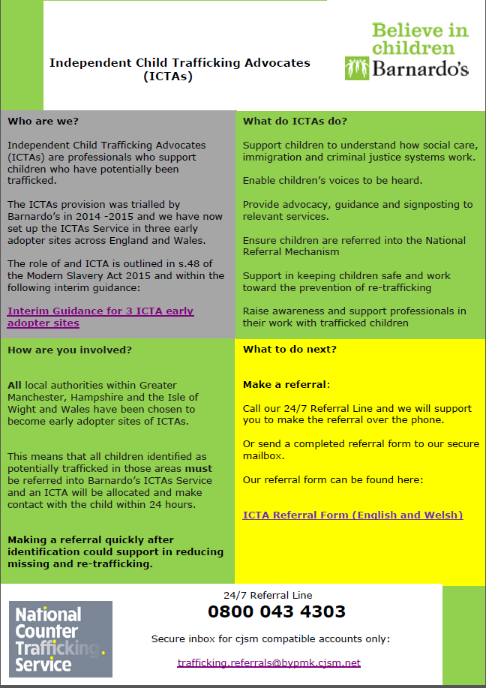
Notes:
Independent Child Trafficking Advocates are being piloted across Greater Manchester, Hampshire and the Isle Of Wight and Wales

Slide 14
MODERN SLAVERY STRATEGY
Refers to the four Ps:
Persue – is prosecute & disrupt individual & groups responsible for slavery
Prevent – people from engaging in slavery
Protect – strengthen safeguards against slavery by protecting people from exploitation & increasing awareness of & resilience against this crime
Prepare – reduce the harm caused by slavery through improved victim identification & enhanced support.
Notes:
Written December 2015

Slide 15
ACTIVITY
In your groups:
What is the definition of your category of person:
Smuggled
Trafficked
Asylum Seeker
Refugee
Migrant Worker
Notes:
In groups: Give each group a piece of flipchart paper.
Get delegates to define what their category is.
Speech bubbles hand-out in packs – this is the definitions activity
Definitions come from the International Organisation for Migration

Slide 16
MIGRANT CATEGORIES
Smuggling – the facilitation, transportation or illegal entry of a person or persons across an international border in violation of one or more countries laws either clandestinely or through deception such as the use of fraudulent documents.
Notes:
Smuggling
People being smuggled as illegal migrants have usually consented to being smuggled. The relationship between an illegal migrant and a people smuggler is a commercial transaction which ends on completion of the journey.

Slide 17
MIGRANT CATEGORIES
Human Trafficking – is the recruitment, transportation, transfer, harbouring or receipt of persons, by means of the threat or use of force or other forms of coercion, of abduction, of fraud, of deception, of the abuse of power or of a position of vulnerability or of the giving or receiving of payments or benefits to achieve the consent of a person having control over another person, for the purpose of exploitation
Notes:
Human trafficking
Victims of trafficking have not consented, or the consent they did give is rendered meaningless by the actions of the traffickers, e.g. deception. However, for those who have been trafficked the very purpose of their journey is to put them into an exploitation situation from which the traffickers can profit. Human trafficking can be categorised as sexual exploitation (rape and prostitution) and non-sexual exploitation (begging, forced labour, domestic servitude, cannabis cultivation, pick-pocketing, human organ transplant, slavery)

Slide 18
MIGRANT CATEGORIES
Asylum Seeker – A person who leaves their own country for their safety, often for reasons of fear of persecution because of race, religion, social group or political opinion & has crossed an international border into a country which he or she hopes will protect them & allow them to live there.

Slide 19
MIGRANT CATEGORIES
Refugee – Is a person who was an asylum seeker, but whose application to remain in the country they have fled to has been successful & they have therefore been granted leave to remain in that country.

Slide 20
MIGRANT CATEGORIES
Migrant Worker – Refers to a person who is engaged or has been engaged in a paid activity in a country of which he or she isn’t a national.

Slide 21
TYPES OF EXPLOITATION
These are fairly wide ranging and often include the following types of conduct:
Sexual Exploitation
Forced Labour
Forced criminality
Domestic Servitude
Organ harvesting
Child Exploitation
Did you know
Labour exploitation is the most recorded form of slavery in the UK, accounting for 45 percent of recorded NRM cases (NCA, 2017)
Notes:
Sexual - frequently through prostitution where victims are placed into off-street brothels, forced to see many clients, and receive either little or no money.
Forced labour - where victims are forced to work very long hours and hand over all of their wages to their traffickers or controllers, e.g. domestic situations as sweatshop factories, construction sites, farm work, paving/ tarmacking, manufacturing, food processing, hospitality
Criminal – drugs, cannabis farming, organised crime, begging, benefit fraud, shoplifting/Theft, Credit card/ATM fraud, Selling Stolen Goods, DVD Pirating and Sales, pick pocketing
Domestic Servitude - victims who live and work in households where they are forced to work through threats of serious harm and physical and sexual assaults, ill treated, humiliated, long hours, unbearable conditions for little or no pay.
Organ harvesting - where victims are trafficked in order to sell their body parts and organs for transplant; eggs, kidneys, liver, eyes (China)
Children - children are amongst the most vulnerable victims; sometimes they are sold into forced labour or domestic work through debt bondage by family members where they are vulnerable to sexual or physical abuse.
This would include the act/means but, the exploitation may yet to take place. Mention to delegates that this would include The Act.
Trainers to note the Home Office typology. 4 sections but 17 types of exploitation.

Slide 22
Exploitation in the workplace what to look for

Slide 23
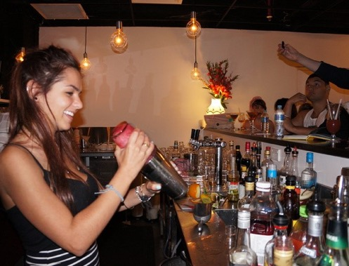
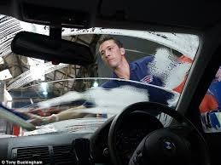
Where are you most likely to encounter exploitation? High risk arenas – low skill – low pay
Working in Bars
Restaurants
Shop work and pack houses
Having your nails done
Having your car washed
In Hotels
On building sites
Leaflet drops
Notes:
Forced labour – exploitative practice can be found in any workplace requiring low skill low pay temporary work force.

Slide 24
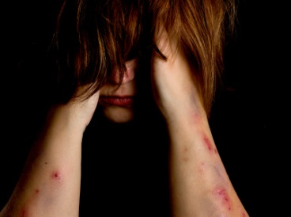
What should I be looking for?
Look at their appearance (unkempt dirty tired)
Any unexplained injuries
Not wearing clothes suitable for work or weather
No communication (Always has someone that speaks for them)
Always taken to and from work
No eye contact
Taken to and from work
Receiving cash for work
No payslips / contracts

Slide 25
WALES’ STRATEGY
Notes:
To be localised for use

Slide 26
TO TACKLE SLAVERY
Awareness Raising
Prevention
Enforcement
Supporting Victims
Agreeing a SPOC within every organisation
These themes are in no order of priority but together will make Wales hostile to Slavery and provide support to victims who have been exploited
Notes:
What have we done so far?
Leadership Group established
Wales Anti Slavery Operational Group
Wales Training Group
Gwent Anti-Human Trafficking Forum
Cardiff Human Anti-Trafficking Forum
Western Bay Anti-Human Trafficking Forum
Third Sector Anti-Human Trafficking Forum
North Wales Anti-Human Trafficking Project
Dyfed Powys Anti-Human Trafficking Forum
Joint Intelligence Board
Wales Sex Worker Group

Slide 27

CPS Prosecutor Commitments
We will build stronger cases to support these most serious offences
We will ensure that the rights and welfare of victims are at the heart of our approach to investigation and prosecution
We will continue to deliver training and development to prosecutors and law enforcement to improve our expertise
We commit to developing and maintaining effective means of engagement with NGOs.
We will work closely together to learn lessons, exchange good practice and share relevant information, data and contacts.

Slide 28
HOW DOES SLAVERY
FLOURISH?

Slide 29
ACTIVITY
Using the case study for your category:
Identify how the person/s have been recruited into slavery?
What makes it easy for them to be controlled and exploited?
Notes:
Give each group a case study based on an exploitation category & get them to answer the 2 questions. Get them time to feedback their answers. They will hopefully have picked out:
Mental or physical health issues
Coming from a history of domestic or other violence
lack of employment or education
Culture and societal norms
Violence: physical & sexual inc harmful traditional practices e.g. juju
What is juju:
The swearing of an oath A ritual
Impacts on support Promise to repay debt and obey the ‘owner’
Ever-binding Breach of contract will bring ‘madness and death’
Inhibits disclosure
Conflict or disaster Poverty
Gender & Equality issues Substance dependency
Demand for cheap labour Family debt
Supporting family back home Better lifestyle
Improved social position in own country Education or employment
Perceived safety A home
Expensive lifestyle Love

Slide 30

What are County Lines?
Drug distribution networks
Moving from saturated highly competitive and violent drug markets to areas of high demand and less violence
Reduces risk for mid level dealers
Notes:
Evan - A drugs line is essentially a development of a business model. People realised that more profits could be made with less risk from both other dealers and from law enforcement agencies.
Whereas essentially before (mid to early 90’s) you would have had one dealer with 10 rocks selling and then going and picking up the next batch now you have two or three dealers dealing 4 rocks each where the charge is likely to be NFA as they run out they then call their elder or lookout who would come and collect the cash and then give them more to sell. The advantage of this is that there is less drugs in the interchange and more likelihood of NFA for all parties.
Mid 90’s saw the increase of drugs lines (with the advent of technology such as mobile phones) and the use of teens building networks which were borough wide.

Slide 31
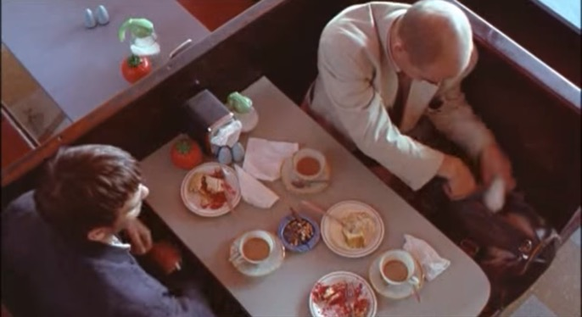
Why now?
Drug distribution as old as drugs
Tended to be middlemen selling larger quantities to local dealers
Now gangs are taking over the market at all levels- sometimes aggressively, sometimes filling a gap
Mobile phones and other technology make it easier to manage distribution from a distance
PNC gang flag alerted the Police of gang involvement
New approach is more violent and exploitative

Slide 32

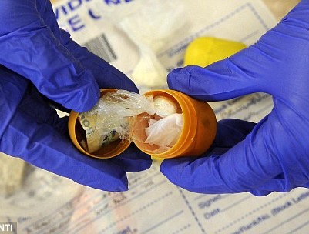
How they operate
‘Line’ means phone line
Senior members operate a drugs line in a specific geographic location.
Drugs supplied from home of a vulnerable person, communal areas in social housing, or open spaces such as parks.
Led by experienced dealer (late teens)
Drugs delivered by young people.
Drugs often concealed in anus.
Young people do most work, take most risks.
Young people are often in care and/ or missing

Slide 33
WHAT ARE THE INDICATORS TO LOOK
OUT FOR?

Slide 34
ACTIVITY
In your groups discuss for your agency type:
What indicates that the person/s may be being exploited?
At what point should your agency intervene?
What would you have done?
Notes:
Give each group an agency type: Social Services, Police, Housing, Border Force, NGO, etc
Based on the case study (to be created locally) they have been given, answer the 3 questions.
Get your groups to feedback
Reinforce NOT waiting for disclosure as that may never happen
Highlight the fact that just because someone is a sex worker doesn’t mean that they can’t be exploited
Indicators Handout in packs both general & health specific
Scenario Agency
1 Child exploitation - Education/Social Services/Police
2 Labour exploitation - DWP/Gangmasters/Police/Border Force
3 Sexual exploitation - Safer Wales/BAWSO/Police
4 Criminal exploitation (vietnamese) – Immigration/College/Police
5 Criminal exploitation (travellers) – DWP/Police/Homelessness/RSPCA

Slide 35
Vulnerability
being susceptible to harm or injury
The offences are about Power, Control and Money. It requires one or more offender to abuse or exploit one or more victims
Notes:
There are many ways that a child or adult can be Vulnerable. This is not just about Modern Slavery, but also Child Sexual Exploitation, Domestic Abuse, Female Genital Mutual, Forced Marriage, Mental health, Prostitution and all aspects of Public Protection
The offences are about Power, Control and Money. It requires one or more offender to abuse or exploit one or more victims

Slide 36
Power and Control can be driven by a number of factors - look out for:
What is the relationship between the offender and victim?
(Parental / Family / work related)
What are the circumstances that contribute to a person being a victim?
(Age / Mental health/ learning disabilities / Addictions / Social Ability)
What does an offender gain from the relationship?
(Control / Money / Belief Systems)
How is a Victim Controlled and Coerced?
(Threats or Violence / Money / Addictions / Moral obligation)

Slide 37
If you have contact with the Public…
Be curious and question relationships if you suspect anything of concern
Look to gain trust and confidence
Identify the risk
Bring a victim to safety

Slide 38
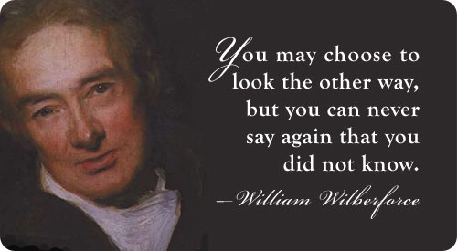
A Simple message
Look, Understand and Help
All Public Services
Private Sector
Third Sector

Slide 39
POLICIES, LAW & SPECIALIST SERVICES
Notes:
To be created using local policies/ legislation/ services
Example legislation that is relevant:
The Care Act (England) 2014
Social Services Wellbeing (Wales) Act 2014

Slide 40
CHILD & ADULT PROTECTION POLICIES
All Wales Child Protection Procedures 2008 includes:
The Protection of Children from Abuse via Information Technology
Safeguarding & promoting the Welfare of Sexually Active Young People
Safeguarding & promoting the welfare of children who are at Risk of Abuse through Sexual Exploitation.
Wales Interim Vulnerable Adult Protection Procedures 2013 includes:
Guidance on Vulnerable Adults involved in Prostitution who do not have the capacity to consent
Guidance for working with Learning Disabled, Mentally Ill, & Older People involved in sexual activity to which they have not the capacity to consent.
Notes:
Prostitution of vulnerable adults unable to consent is a form of sexual exploitation and the vulnerable adults involved must be viewed as potential victims of abuse.
This exploitation takes the form of the exchange of sexual activities by these vulnerable adults without the ability to consent for commodities such as money, drink, drugs, shelter, protection, accommodation etc. and is often perpetrated by an adult through coercion, threats or violence. The involvement of an adult who is unable to consent in prostitution, whether a male or female, is abuse in itself and must be responded to accordingly.
SHOW A COPY OF THE WALES OPERATIONAL HANDBOOK

Slide 41
OTHER GUIDANCE
Modern Slavery Act 2015
All Wales Practice Guidance for Safeguarding Children Who May Have Been Trafficked
Violence Against Women, Domestic Abuse & Sexual Violence (Wales) Act 2015
Social Services Wellbeing (Wales) Act 2014
UN Convention Rights of the child
Human Rights Act
Working Together to Safeguard
Sexual Offences Act 2003
Notes:
The Right to be Safe” - is the Welsh Assembly Government’s six year integrated strategy for tackling all forms of violence against women
Rights of the child – a human rights treaty for children. Ratified by all countries bar USA, South Sudan & Somalia.
Human rights act – Articles 2 Right to life, Article 3 Prohibition of torture, Article 4 Prohibition of slavery & forced labour, Article 5 Right to liberty & security.
Working together to safeguard – comes from the Children Act 1989. Wales protocol.
Sexual offences act - The legislation covers everyone but also gives extra protection to 16 and 17 year-olds. It is illegal to take, show or distribute indecent photographs, pay for or arrange sexual services, or for a person in a position of trust (e.g. teachers, care workers and sports coaches) to engage in sexual activity with anyone under the age of 18.
Other activities it covers for everyone are:
Voyeurism is the sexual interest in or practice of spying on people engaged in intimate behaviours, such as undressing, sexual activity, or other actions usually considered to be of a private nature.
Assault by penetration includes penetration of the mouth with a part of the body or something else – as does rape
Sex Tourism is travelling abroad for the purpose of committing a sexual offence – yet to be enforced by a test case in UK.
Child pornography – the age has changed from 16 yrs. or under to 18.
Sexual grooming where a person has met or communicated with a minor on at least 2 occasions and subsequently intentionally arranges to meet with that minor with the intent to do anything to them either during or after the meeting & does not reasonably believe the minor is 16 or over.
Brothels includes allowing a premises to be used for the purpose of sexual activity.
Child Sex Offences include sexual activity with a child, causing or inciting a child to engage in sexual activity, engaging in sexual activity in the presence of a child & sexual offences committed by a child or young person.
Familial Child sex offences – e.g. incest
Administering substances or causing a substance to be taken with the intent of stupefying or overpowering so a person can engage in sexual activity.

Slide 42
CHILDREN?
A Child is anyone who has not yet reached their 18th birthday and are entitled to service and protection under the Children Act 1989
According to the Social Services and Well-being (Wales) Act 2014:
a child at risk” is a child who—
(a) is experiencing or is at risk of abuse, neglect or other kinds of harm, and
(b) has needs for care and support (whether or not the authority is meeting any of those needs).
Notes:
Can receive services up to 25 years if in education or training.
Children/young people who are at risk of sexual exploitation should be considered to be: a child in need and/or a child in need of protection
Need to use relevant local legislation

Slide 43
MODERN SLAVERY ACT 2015
Introduces offences – England and Wales 31 July
Penalties
Prevention and Risk Orders
Independent Anti-Slavery Commissioner
Protection of Victims
Transparency in the Supply Chain October 2015
Notes:
An overview of the offences
Consolidate and simplify existing slavery and trafficking offences to provide clarity and focus when investigating and prosecuting traffickers
Increase the maximum sentence available to life imprisonment so that offenders receive the punishments they deserve;
Introduce civil orders to restrict the activity of those who pose a risk and those convicted of slavery and trafficking offences, strengthening our ability to cut this criminality;
Create a new Anti-Slavery Commissioner role to galvanise law enforcement’s efforts to tackle modern slavery;
Establish a legal duty to report potential victims of trafficking to the National Crime Agency (NCA) to build a clearer picture of the nature of this hidden crime.

Slide 44
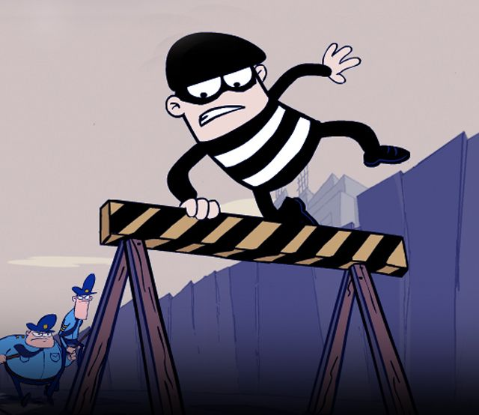
I am a Victim !!!!
Notes:
This relates to section 45 of the Modern Slavery Act 2015

Slide 45
Section 45 Modern Slavery Act 2015
45 Defence for slavery or trafficking victims who commit an offence
(1)A person is not guilty of an offence if—
(a)the person is aged 18 or over when the person does the act which constitutes the offence,
(b)the person does that act because the person is compelled to do it,
(c)the compulsion is attributable to slavery or to relevant exploitation, and
(d)a reasonable person in the same situation as the person and having the person’s relevant characteristics would have no realistic alternative to doing that act.
Notes:
Overview of section 45 of the Modern Slavery Act 2015

Slide 46
Section 45 cont.
(4)A person is not guilty of an offence if—
(a)the person is under the age of 18 when the person does the act which constitutes the offence,
(b)the person does that act as a direct consequence of the person being, or having been, a victim of slavery or a victim of relevant exploitation, and
(c)a reasonable person in the same situation as the person and having the person’s relevant characteristics would do that act.

Slide 47
PROCEEDS OF CRIME
Classed as lifestyle offences
Powers under the Proceeds of Crime Act 2002
Also consider money laundering
Financial Investigator appointed
All assets from previous 6 years available
Referral to HMRC
Carefully consider acceptance of pleas
Notes:
All human trafficking offences are classed as “lifestyle offences” and the court may use it’s powers under the proceeds of crime act 2002 to restrain and confiscate the value of a defendants criminal assets.
You should also consider money laundering charges.
Make sure that a financial investigator is appointed to examine the defendants bank accounts and assets.
The court assumes that all assets acquired in the previous 6 years are the proceeds of crime and are available to be confiscated.
In ALL cases consider a referral to the HMRC.
It is also important to carefully consider the acceptance of pleas.

Slide 48
BARNARDO’S CYMRU SERAF
1:1 support for young people trafficked for sexual purposes
Access to counselling service
Access to Barnardo’s interpretive services
Consultation, support and advice: with completion of trafficking risk matrix & attendance at strategy meetings
Signposting
Notes:
Worked in this area since 1995 – first service Street and Lanes Bradford
Successful in raising public, political and professional awareness of sexual exploitation
Barnardo’s has sought to influence policy and practice and to develop effective inter agency approaches to service provision for young people
Instrumental in redefining the issue as one of child abuse rather than juvenile prostitution
Trainers to note:
Localise this for relevant local providers’ practice and procedures

Slide 49
PRIVATE FOSTERING
Is when a child under the age of 16 (18 if disabled) is cared for by someone who is not their parent or a close relative for 28 days or more.
Agencies (especially Schools) have highlighted indicators such as:
Several children with same name or date of birth
Children who speak different languages from “same” family
“Parent” who doesn’t know child’s allergies or medical history
“Parent” who doesn’t speak the same language as their child
Different religions within a “family” unit
Notes:
There are occasions when birth parents smuggle their children into the United Kingdom for a variety of reasons & inadvertently subject their children to traffickers who agree to the contract with a child’s birth parents but whose intention is to exploit. The adult in this scenario may be a distant relative or friend of the family.
“There can be no excuse or justification for failing to take adequate steps to protect a vulnerable child, simply because that child’s cultural background would make the necessary action somehow inappropriate”. Lord Laming, 2003
EMTAS handout in their packs showing some of the disclosures from education during a couple of training sessions.

Slide 50
AGE DISPUTES
Where there is concern that a child or young person may have been trafficked and an age dispute arises, the “child” should be given the benefit of the doubt as to their age until the safeguarding and trafficking issues have been addressed
Council of Europe’s Convention on Action Against Trafficking in Human Beings
Notes:
Young people may have no identifying information on them, their documents may be false or they may have been told to lie about their age to evade attention from the authorities. Some victims may claim to be adults when they are in fact under 18 years of age.
Those over 18 may well say they are children so they will be put in foster care or a children’s home from which they can abscond easily & disappear rather than be put in jail.
It is imperative that an age assessment is carried out ASAP
Where there is uncertainty about a suspected victim's age, Children's Services will be responsible for assessing their age. The Local Authority in whose area the victim has been recovered will have responsibility for the care of the child as required by the Children Act 1989.
Where a person is brought before any court and it appears that they are a child or young person, it is the responsibility of the court to make due enquiry as to their age. Under section 99 Children and Young Persons Act 1933 and section 150 Magistrates' Courts Act 1980 the age presumed or declared by the court is then regarded to be their true age.
An age assessment MUST be carried out by an experienced trained social worker.
Assessing age handout in their packs.

Slide 51
FAMILY TRACING
Salvation Army
Latter Day Saints
Red Cross
Notes:
These are the agencies at present who are able to assist in tracing families

Slide 52
MY DANGEROUS LOVERBOY
DVD
Notes:
This is a 20minutes dvd ( other DVDs can also be used).
The dvd shows how easy it is for a person to be led in to situation they don’t comprehend or recognise as exploitative.
While this dvd depicts a young girl it is imperative to stress that boys are also vulnerable to this & adults too.
Current trends from Barnardos:
Peer led exploitation
Use of technology
Organised exploitation
Internal trafficking
Older boyfriend/’Loverboy model’
Informal economies
Survival sex
Party scene
Identity
Commodity

Slide 53
THE NEXT STEPS

Slide 54
SUSPECTED VICTIM?
Safety of victim
Emergency services
SPOC – Single point of contact
First Responder
Consent to refer to NRM (no consent needed for a child)
Notes:
We will discuss consent next
Your SPOC to refer to should be twofold – your safeguarding officer within your organisation & your trafficking Police SPOC in your Area
Please ensure that YOU have told BOTH SPOCs, don’t assume that someone else will have done it.

Slide 55
WHAT TO DO IF YOU SUSPECT?
Before talking to potential victim, isolate individual from person accompanying her/him without raising suspicions.
Strict confidentiality is paramount.
Use a qualified, CRB checked translator/interpreter who understands victim’s cultural needs.
Use indirect questions – phrase trafficking or slavery victim may have no meaning. They may deny they are a victim of these
Make no promises & be careful not to be judgmental
Refer to your manager or local safeguarding lead.
Notes:
Individual accompanying person may be trafficker posing as spouse, other family member or employer.
Reassure them about confidentiality
Do not let concerns you may have about challenging cultural beliefs stand in the way of assessing safety, especially of a child (lesson from serious case reviews)
Try to find out more about the situation but be careful not to use leading questions: Use TED (as with safeguarding) Tell me…., Explain to me….., Describe to me….
Ensure that you use the words – “I think this person has been trafficked” or I think this person is a victim of human trafficking”
Translation/Interpreter Services:
Ensure that interpreters used are approved and accredited.
Do not use other potential victims as interpreters as they may be offenders and or influencing the potential victim.
Ensure the interpreter is aware of the potential traumatic nature of the case and the potential length of the investigation.
Consider the gender of the interpreter and potential victims.
Ensure conversation is accurately recorded.
If a telephone interpretation service is used ensure that they are making adequate records and the call is recorded

Slide 56

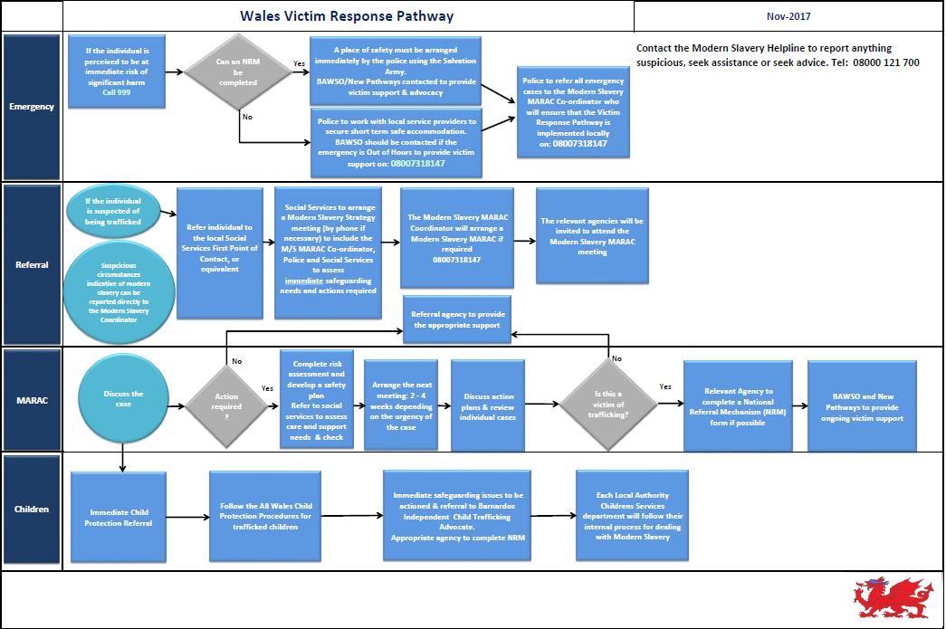

Slide 57

Powered by Unseen
08000 121 700

Slide 58

Modern Slavery Helpline
Confidential
UK-wide
24/7, 365 days a year
Calls from potential victims, members of the public, statutory agencies and businesses
Resource Centre including directory of services
Referrals to the police, NGOs, and local authorities (anonymously if preferred)
Notes:
The helpline was set up on 10 October 2016 and took over the number previously used by the NSPCC. The helpline takes calls 24/7, 365 days a year from across the UK and has also taken a number of international calls. We use translation services to speak with those who cannot speak English.
The helpline is confidential. If a caller doesn’t want the police or other agencies to know who they are we will anonymise any referral. The only exception is where a child is involved or there is a risk of imminent harm to an individual.
The Resource Centre is a hub of information and tools designed to provide access to information, advice and guidance from Unseen as well as other organisations working in the modern slavery field. The directory of services seeks to provide a comprehensive view of services available in location and by service type. To provide a better understanding of the type and nature of calls received, the helpline publishes regular statistics and ad-hoc reports which it shares with partners and puts onto its website
The helpline receives around 65 -70 calls per week. Calls usually come from potential victims wanting advice or support, statutory agencies and businesses wanting information or guidance, and the public reporting tip-offs.
The Helpline is supported by many organisations including: the Wales Government, Scotland Government, Northern Ireland Assembly, the Home Office, Border Force, the Police, the National Crime Agency, and a number of businesses (BT,

Slide 59
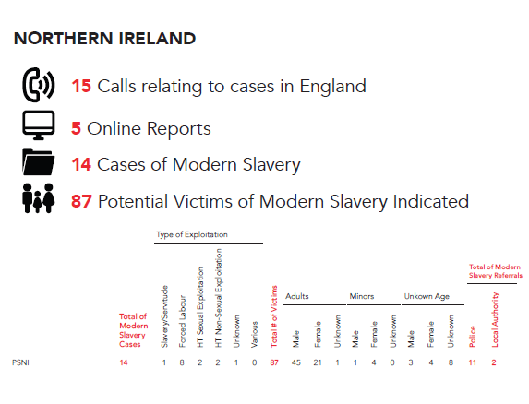

Slide 60
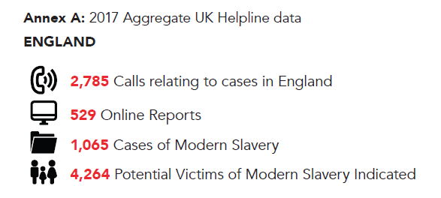

Slide 61
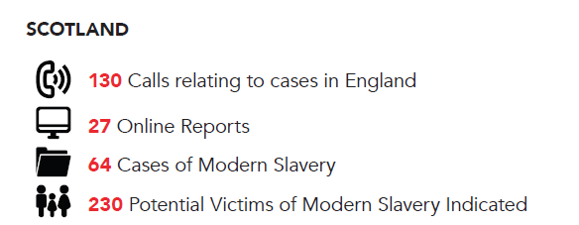

Slide 62
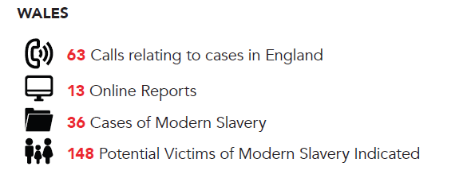

Slide 63
ADULTS
If they want help to leave now & GIVE CONSENT:
As a First Responder, complete National Referral Mechanism form using the Constituent Elements and submit:
Remember - Only make referrals if the person is able to give consent
Provide information & let them know what will happen next
Complete the duty to notify form (MS1).
Notes:
The person completing the referral form is known as the first responder
From 1 November 2015, specific public authorities have a duty to notify the Secretary of State of any person identified in England and Wales as a suspected victim of slavery or human trafficking.
Where a specified public authority has reasonable grounds to believe that a person may be a victim of slavery or human trafficking, it must notify the Home Office.
If the person consents to enter the national referral mechanism (NRM), you use the NRM form.
If the person has not consented to enter the NRM, you can send the ‘MS1: notification of a potential victim of modern slavery form’,
See “Duty to Notify the Home Office of Potential Victims of Modern Slavery
Guidance for Specified Public Authorities - Version 2.0 (18 March 2016)
BEFORE a first responder agency sends off their NRM form they MUST ensure that they have checked it is appropriate with BAWSO OR NEW PATHWAYS. To ensure a positive outcome where possible.

Slide 64
What is Duty to Notify?
From 1 November 2015, specified public authorities have a duty to notify the Secretary of State of any individual encountered in England and Wales who they believe is a suspected victim of slavery or human trafficking.
The ‘duty to notify’ provision is set out in Section 52 of the Modern Slavery Act 2015 This duty is intended to gather statistics and help build a more comprehensive picture of the nature and scale of modern slavery.

Slide 65
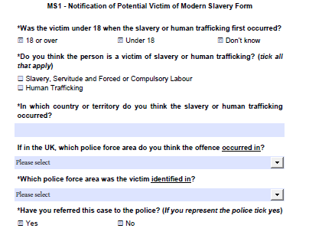
DUTY TO NOTIFY FORM
Applies to the following public authorities in England and Wales although additional public authorities can be added through regulations:
(a) a chief officer of police for a police area,
(b) the chief constable of the British Transport Police Force,
(c) the National Crime Agency,
(d) a county council,
(e) a county borough council,
(f) a district council,
(g) a London borough council,
(h) the Greater London Authority,
(i) the Common Council of the City of London,
(j) the Council of the Isles of Scilly,
(k) the Gangmasters Labour Abuse Authority.
Home Office staff within UK Visas and Immigration, Border Force and Immigration Enforcement are also required, as a matter of Home Office policy, to comply with the duty to notify.
An MS1 form should only be used if the potential adult victim wants to remain anonymous and does not want specialist support (or if you are not able to contact the potential victim and do not know their personal details). The MS1 form is available on the gov.uk website www.gov.uk/government/publications/duty-to-notify-the-home-office-of-potential-victims-of-modern-slavery

Slide 66
ADULTS
If they DON’T want help to leave now:
Provide information about assistance and support
Be aware that any written material could be detected
Try to arrange a follow-up appointment
If the adult is responsible for a child- remember child protection procedures

Slide 67
CHILDREN
Follow child protection guidelines
Speak to your designated child protection lead and ensure NRM is completed
Contact your local Children’s Social Services specifically highlighting your concern for child exploitation OR the police in an emergency
Contact ICTA – Independent Child Trafficking Advocates
Notes:
MANDATORY COMPLETION OF NRM FOR CHILDREN

Slide 68
FIRST RESPONDER
PRIORITY
First steps – “the escape from exploitation”
SECONDARY
2. Secure accommodation
3. Recovery and reflection period
Risk assessment and safety plan
Support and exit plans
YOU MAY ONLY GET ONE CHANCE TO SAVE A LIFE
Notes:
Emergency Multi Agency Risk assessment police intervention
Preserve the dignity of victims of trafficking, to protect and care for them in safe accommodation, and to give them access to services such as legal advice, health care and counselling as well as educational opportunities.
Submit an NRM form to set off a session of emotional support and advocacy
Which could consist of voluntary repatriation, a move into independent accommodation as part of UK community, or asylum support
Possible reception centre required
Police to consider Europol/ Interpol for enquiries.
Trainer Notes: Consider usignt he LGA guidance from the Human Trafficking Foundation
68

Slide 69
NATIONAL REFERRAL MECHANISM
UK has two ‘Competent Authorities’, with trained case owners who make decisions on whether someone is a victim of trafficking.
The 2 Competent Authorities :
Non EU - UKVI – UK Visas & Immigration
EU - National Crime Agency – NCA – Modern Slavery Human Trafficking Unit.
Notes:
The National Referral Mechanism is a process set up by the Government to identify and support victims of trafficking in the UK. It was born out of the Government's obligation to identify victims under the Council of Europe Convention on Action against Human Trafficking, which came into force on 1 February 2008.
Show copies of a child & adult blank NRM to each group.
A positive conclusive grounds decision is beneficial to the victim’s case.

Slide 70
NATIONAL REFERRAL MECHANISM
Contact key agencies for
information during
consideration process.
UKHTC receives referral
from First Responder
Consideration of referral
No appeal
mechanism.
Decision letter sent
to referrer
Reasonable Grounds Decision
NO
YES
Able to access temporary
safe housing through
Local Authority /
Salvation Army
45 Day recovery and
reflection period
No appeal
mechanism.
immigration
process continues
Conclusive Decision
NO
YES
YES
Internally Trafficked
local outreach support
Including Doctor, benefits,
housing, etc.
Residence Permit
No residence permit
Relevant immigration
process
continues
Notes:
70
Stage One – “Reasonable Grounds”
The NRM team has a target date of 5 working days from receipt of referral in which to decide whether there are reasonable grounds to believe the individual is a potential victim of human trafficking. This may involve seeking additional information from the first responder or from specialist NGOs or social services. The threshold at the Reasonable Grounds stage for the case manager is “From the information available so far I believe but cannot prove” that the individual is a potential victim of trafficking.
If the decision is affirmative then the potential victim will be allocated a place within Ministry of Justice safe house accommodation, if required granted a recovery and reflection period of 45 days. This allows the victim to begin to recover from their ordeal and to reflect on what they want to do next, for example, co-operate with police enquiries, return home etc.
Stage 2 – 45 day recovery & reflection period
Appropriate and secure accommodation, psychological and material assistance
Access to emergency medical treatment
Translation and interpretation services, when appropriate
Counselling and information, in particular as regards their legal rights and the services available to them, in a language that they can understand
Assistance to enable their rights and interests to be presented and considered at appropriate stages of criminal proceedings against offenders
Stage Three – Conclusive Decision
During the 45 day recovery and reflection period the CA (Competent Authority) gathers further information relating to the referral from the first responder and other agencies.
This additional information is used to make a conclusive decision on whether the referred person is a victim of human trafficking. The CA’s target for a conclusive decision is within the 45 recovery and reflection period.
The case manager’s threshold for a Conclusive Decision is that on the balance of probability “it is more likely than not” that the individual is a victim of human trafficking.
The first responder and the potential victim will both be notified of the decision. If the referred person is conclusively identified as a victim of trafficking, what happens next will depend on their wishes.

Slide 71
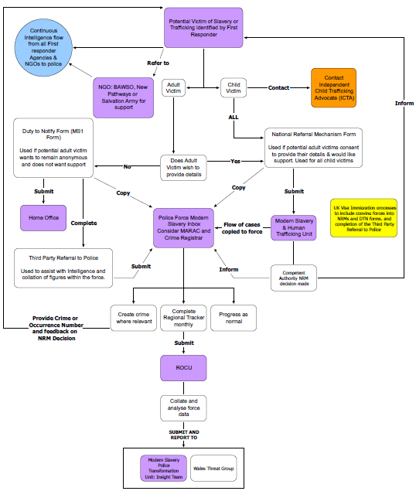
Wales Anti-Slavery NRM and Duty to Notify Process MAP
Updated April 2017
Notes:
Wales version of the NRM and Duty to Notify Process Map

Slide 72
INITIAL REACTION:
REASSURE THE PERSON – their safety and confidence is paramount
Keep multiple victims separate – possible reception centre
Think victim care – culture, language, gender, religion, possible trauma
Victim not left isolated
Are any others at risk?
Make them feel safe and supported
Immediate Needs of the Victim.
Notes:
Firstly, respect the rights, choices, and dignity of each individual
Warmth, Empathy, Listening
Conduct interviews in private settings
Option of male or female staff
Do not judge
Do not re-victimize
Be patient
Ask only relevant, necessary questions
Avoid multiple interviews
Assessment of immediate risk
Don’t leave the victim on their own even if you’re just getting them a drink – it’s important not to re-victimise the person & by leaving them alone with no idea whether you’ll come back or not (like the trafficker) you could do this without thinking.
Use open questions & remember certain phrases e.g. trafficking victim, may have no meaning. They may deny they are a victim of trafficking
Tell me about…..
Explain to me……
Describe to me……
Clarifying questions you may need to use:
Could you leave your job if you want to?
Could you come and go as you please?
Have you been hurt or threatened if you tried to leave?
Has your family been threatened?
Do you live with your employer?
Where do you sleep and eat?
Are you in debt to your employer?
Do you have your passport/identification? Who has it?

Slide 73
Booking into Centre & Consent Forms - Police
GP triage emergency needs examination
Food & Drink provision.
Forensic Medical
Examination &
Clothing seizure
Initial assessment
Interview with police
Blood
sampling
Identification
Fingerprints / photo
External
Medical care
Salvation army clothing / Shower / Food & Drink
Full GP examination and health check
Police
Interview
New
Clothes
UKHTC
Forms
Social
Care
Housing
Job
Centre
Skeletal
Survey
Ongoing
Bloods
Ongoing
Medical
Care
Any
Other
Needs
Multi – Agency Information Sharing Daily Meetings
Victim’s Housed and depart centre with ongoing multi-agency support
Multi- Agency Reception Centre Process Map

Slide 74
ACTIVITY
Using the case study provided, in your group decide what information is pertinent to go in to the NRM form to ensure that your victim has the best chance of getting a POSITIVE reasonable grounds decision.
What questions do you need to ask to gain further information to complete your NRM form? - Even if this means a delay in the submission.
Notes:
Give some groups a child case study & others adult versions.
SHOW A WELL COMPLETED FORM.

Slide 75
What are the key points needed for your NRM form?
Trafficking details
Movements that took place- Routes/travel/ where from and to
In the EU/ Out of the EU/ within the EU (international trafficking)
Nature of exploitation
How did the first responder encounter the victim?
Possible time-frame of the exploitation.
Adult or Child
If Adult – what were the means of control of the victim?
EVERYTHING YOU CAN ADD HELPS THE VICTIMS OPPORTUNITY OF SECURING TRAFFICKED VICTIM STATUS

Slide 76
WHAT ARE THE BARRIERS?

Slide 77
DISCLOSURE BARRIERS
Many victims do not speak English
Traffickers may “coach” victims to answer questions with a cover story and do not leave their side
Victims fear of reprisals for themselves or family
Fear of being sent back to their country of origin
Immigration status
Involvement in criminal activity
Juju
Self-blame
Stigma
‘Stockholm Syndrome’
Women exploited in domestic servitude may have a sense of responsibility to the children they care for.
Do not identify themselves as a victim
Notes:
Are unable to communicate with service providers, police, or others who might be able to help them.

Slide 78
EMOTIONAL BARRIERS
Fear
Guilt
Anger
Suspicion
Hopelessness
Betrayal
Notes:
Fear: of retribution by trafficker, of being criminally prosecuted and punished, and of being thought of as a prostitute
Guilt: for allowing oneself to be deceived, for violating the law and/or religious beliefs, for failing to raise the money needed by the family
Anger: with themselves for getting into this type of a situation, with those who didn’t defend them and with society in general
Suspicion: of one’s own ability to defend oneself against those that betrayed him/her.
Hopelessness: About one’s future, that their situation will not improve. This is a strong indicator of longer-term depression.
Betrayal: by a person they trusted, by society for not intervening to protect them.

Slide 79
DERBYSHIRE POLICE DVD
Notes:
7 MINS long.
If you have time you can end with this.
Complete evaluations

Slide 80
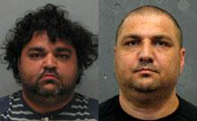
THE MARCINS
Brothers Marek and Igor Marcin lived in a typical Derby semi.
They trafficked men into the UK from Slovakia and the Czech Republic.
Notes:
They housed 11 workers in a three-bedroomed house
They controlled all their bank accounts
They paid them between £5 and £20 pw
They claimed benefits in their names
They wore expensive jewellery
They drove expensive cars
Their wives stole ‘ready cash’ from the workers
They made in excess of £1.3 million

Slide 81
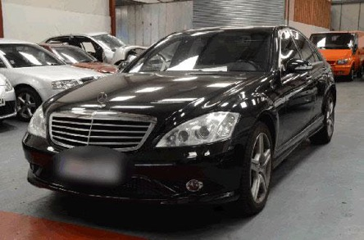

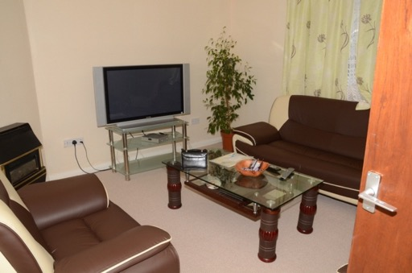
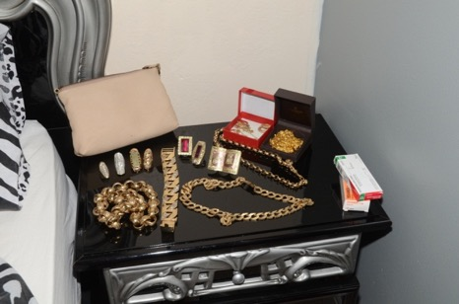

POWER AND PROFIT
Notes:
These were photos of the traffickers home

Slide 82
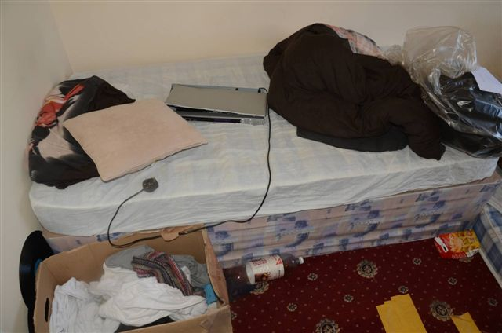
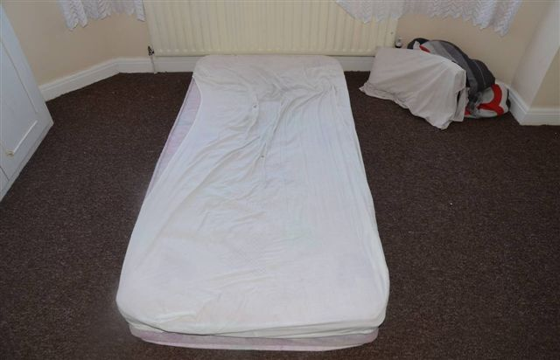
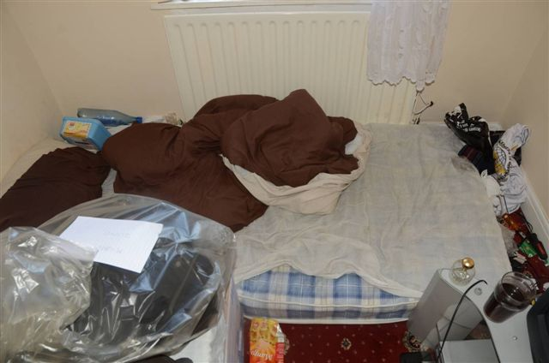
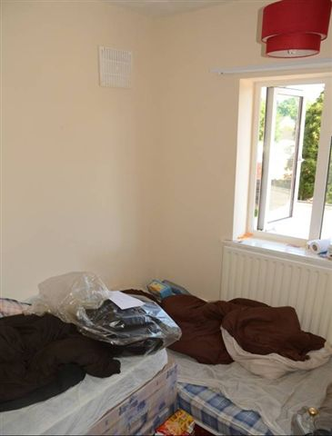
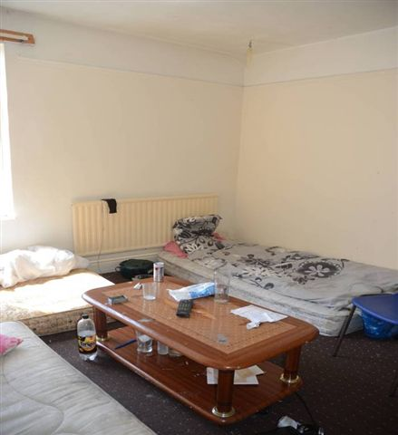
Fear and hope
Notes:
11 workers were rescued from the Marcins’ control
All entered the National Referral Mechanism for victims of trafficking
Eight were assisted in returning to their homeland
Three remained in the UK
They wanted to stay and work for a decent wage
OUTCOME:
Marek and Igor Marcin and their wives were arrested on 15 July 2013
In February 2014 both men admitted human trafficking charges
Marek got 40 months in prison – Igor got 52 months
Marek’s wife Gabriela (right) received an eight month sentence for theft.
Igor’s wife, Dagmar, got 10 months

Slide 83
SAFETY PLANNING

Slide 84
WHAT TO THINK ABOUT
Risk on return to country/place of origin
Risk from family/friends
Risk of being identified/located by trafficker/trafficker’s associates
Contact with those in the trafficking network
Risk of reprisals from trafficker/trafficker’s associates
Risk of physical/sexual violence
Risk from acting as a witness
Other risk taking behaviour
Notes:
What to consider when completing a SAFETY PLAN.
Risk of being re-trafficked or killed, or family members being killed to force them back in to it.

Slide 85
WHAT TO THINK ABOUT
Self-harm
Suicidal ideation/suicide attempts
Harm from substance misuse
Harm from mental health issues, including Post Traumatic Stress Disorder
Abuse/harassment by other service users
Aggressive behaviour (to other service users or staff)
Victim can become an ALPHA
Notes:
Suicidal – linked to the shame of what has happened.
ALPHA – a victim who grooms &/or recruits others into exploitation

Slide 86
ACTIVITY
Using the previous case study decide :
What the risks could be for your victim
Which agencies you need to involve to keep the victim safe
Notes:
Using same case study as previous activity.
Highlight that this process takes place at MARAC or local procedures. That a multi-agency approach is required to safeguard the individuals & agree between agencies who will do what when & where.

Slide 87
HORSE TRADER DVD
Notes:
https://www.youtube.com/watch?v=k-I5EtcewdM
7 MINS long.
If you have time you can end with this.
Complete evaluations

Slide 88
Next steps...

Slide 89
WHAT NEXT….
Identify 3 things you are going to do in your workplace that will raise awareness of this heinous crime
Notes:
Give a copy of Competency Framework

Slide 90
FINALLY……
Notes:
Feedback of your NRM submissions

Slide 91
THANK YOU AND QUESTIONS
Notes:
After the course tell delegates to add the modern slavery helpline number to their phone.
Modern Slavery Helpline
08000 121 700

Slide 92
Key Websites
www.wales.gov.uk/anti-slavery/
https://www.modernslaveryhelpline.org/
http://www.cps.gov.uk/wales/

